Slide 1
DON’T-CARE CONDITIONS

Slide 2
DON’T-CARE CONDITIONS
The logical sum of the minterms associated with a Boolean function specifies the conditions under which the function is equal to 1. The function is equal to 0 for the rest of the minterms.
This pair of conditions assumes that all the combinations of the values for the variables of the function are valid.
In practice, in some applications the function is not specified for certain combinations of the variables. As an example, the four-bit binary code for the decimal digits has six combinations that are not used and consequently are considered to be unspecified

Slide 3
DON’T-CARE CONDITIONS
Functions that have unspecified outputs for some input combinations are called incompletely specified functions . In most applications, we simply don’t care what value is assumed by the function for the unspecified minterms.
For this reason, it is customary to call the unspecified minterms of a function don’t-care conditions . These don’t-care conditions can be used on a map to provide further simplification of the Boolean expression.

Slide 4
DON’T-CARE CONDITIONS
A don’t-care minterm is a combination of variables whose logical value is not specified.
Such a minterm cannot be marked with a 1 in the map, because it would require that the function always be a 1 for such a combination. Likewise, putting a 0 on the square requires the function to be 0.
To distinguish the don’t-care condition from 1’s and 0’s, an X is used. Thus, an X inside a square in the map indicates that we don’t care whether the value of 0 or 1 is assigned to F for the particular minterm.

Slide 5
DON’T-CARE CONDITIONS
In choosing adjacent squares to simplify the function in a map, the don’t-care minterms may be assumed to be either 0 or 1.
When simplifying the function, we can choose to include each don’t-care minterm with either the 1’s or the 0’s, depending on which combination gives the simplest expression.

Slide 6

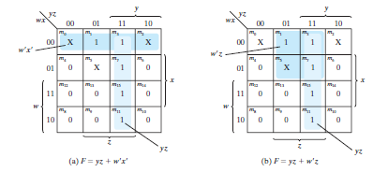

Slide 7
HDL Description of The Simplified Function
F = YZ+W’X’
// Verilog model: Circuit with Boolean expressions
module Circuit (F, W, X, Y, Z);
Output F;
Input W, X, Y, Z;
assign F = (Y && Z ) || ((! W) && (! X) );
endmodule

Slide 8
HDL Description of The Simplified Function
F = (A’+B’)(C’+D’)(B’+D)
// Verilog model: Circuit with Boolean expressions
module Circuit (F, A,B,C,D);
Output F;
Input A, B, C, D;
assign F = ((! A) || (! B) ) && ((! C) || (! D) ) && ((! B) || D );
endmodule

